Slide 1

Machine learning Regressor Boosting Algorithm
1.Ada Boost Algorithm

Slide 2
ADA Boost Algorithm Regressor
Adaboost stands for adaptive boosting.
The models are sequentially arranged in the ensemble.
This means that at each step we try to boost our weak learners based on the mistakes of our previous models so together they are one strong ensemble model.
Each model has a part of the problem they perfom well at, so together the cover all parts of the problem.

Slide 3
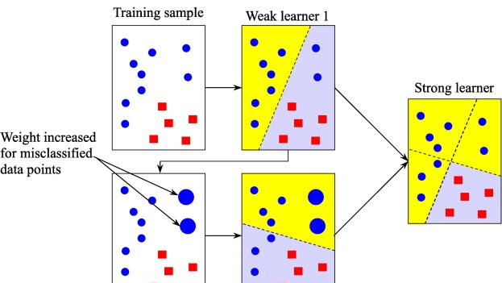

Slide 4


Calculate the weighted error E₁ of the first model:
Compute the amount of say for the first model:

Slide 5



Update weights:
Correctly classified samples' weights are decreased:
Misclassified samples' weights are increased:
Normalize the weights so that the sum of weights equals 1:

Slide 6
Key Takeaways
Adaboost is an ensemble learning technique used to improve the predictive accuracy of any given model by combining multiple “weak” learners.
Adaboost works by weighting incorrectly classified instances more heavily so that the subsequent weak learners focus more on the difficult cases.
It is adaptive in the sense that subsequent weak learners are tweaked in favor of those instances misclassified by previous classifiers.
Adaboost is fast, simple to implement and versatile.
It is highly effective in binary classification problems and can be used to solve multi-class classification problems.
Adaboost is not suitable for noisy data and is sensitive to outliers.

